Slide 1







AI-Powered Multi-Modal Logistics & Transportation Optimization Platform
INTRODUCTION:
An enterprise-grade decision-intelligence system unifying road, rail, sea & air logistics — optimizing routes, fleets and warehouses in real time.
AI-Powered
Multi-Modal
Logistics
Machine learning models drive predictive, autonomous decisions
Seamless coordination across truck, train, ship & air freight
End-to-end supply chain visibility & coordination
Transportation
Optimization
Platform
Real-time tracking of fleets & shipment movement
Algorithmic efficiency for cost, time & resources
A unified, scalable enterprise software system
REAL-WORLD SCALE
Flipkart's Big Billion Days & Amazon's Great Indian Festival route millions of parcels across trucks, trains, ships & flights simultaneously — this platform models exactly that complexity, optimizing every leg in real time.

Slide 2

DOMAIN MAPPING
Project Domain
A single intelligent platform spanning seven interconnected disciplines.
Transportation
Management
Logistics
Optimization
Route
Optimization
Supply Chain &
Logistics
Management
Artificial
Intelligence
Predictive
Analytics
Warehouse
Management
Enterprise Web
Application

Slide 3





Technology Stack
A production-grade, full-stack foundation engineered for scale, intelligence and real-time performance.
Frontend
Backend
Database
Data Structures & Algorithms
React.js · Tailwind CSS · Recharts · Mapbox / Leaflet
Node.js · Express.js · REST APIs · WebSockets
MongoDB · PostgreSQL · Redis Cache
Dijkstra & A* · Graph Theory · Priority Queues
Artificial Intelligence
Visualization
Logistics Components
Route Prediction ML · Demand Forecasting · Reinforcement Learning
D3.js · Live Dashboards · GeoSpatial Maps
Fleet Management · Warehouse Mgmt · Multi-Modal Routing
Full-Stack + Artificial Intelligence + Logistics Intelligence

Slide 4




WHY THIS MATTERS
Problem Statement
During Flipkart's Big Billion Days & Amazon's Great Indian Festival, order volumes spike 5-10x overnight — exposing critical gaps in logistics infrastructure.
›
›
›
›
Delivery
Delays
Warehouse
Congestion
Route
Inefficiencies
Transportation
Cost
Resource
Allocation
Last-mile windows slip 2-3x at peak demand
Fulfillment centers exceed 90% capacity
Static routing ignores live traffic & demand
Fuel & fleet costs rise 20-30% under surge
Manual planning misbalances fleet & staff
5-10x
30%
40%
Order Volume Surge
Cost Overrun Risk
Delivery SLA Breaches

Slide 5
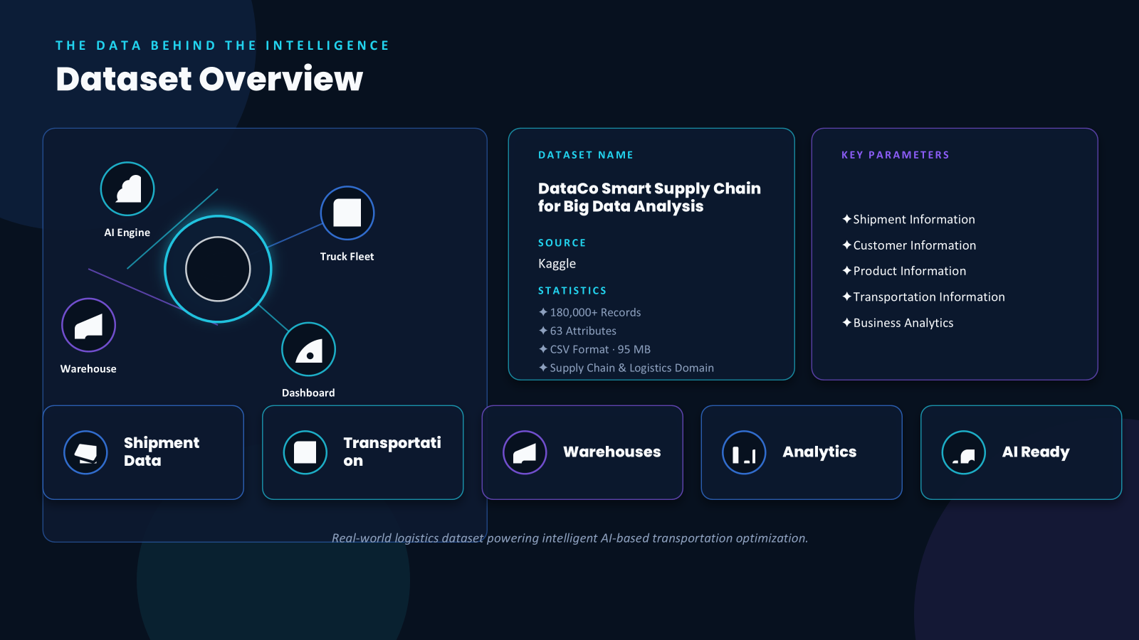

Slide 6


WHERE WE'RE HEADED
Project Objectives
Route Optimization
Dijkstra / A* powered shortest & fastest paths
Seven measurable outcomes anchored to one strategic objective.
Resource Allocation
Optimal assignment of vehicles, drivers & warehouses
Project
Objectives
AI Decision Support
Predictive models guiding real-time logistics decisions
Multi-Modal Transportation
Unified coordination across road, rail, sea & air
Logistics Analytics
Live dashboards for KPI monitoring & insight
Cost Reduction
Minimizing operational & fuel expenditure
Improved Delivery Performance
Faster, reliable, on-time delivery at scale

